Slide 1

Scripting & Parallelization
SLURM
Sbatch, JobArray, OpenMP/MPI
Daniel Valle Millares
(Bioinformatics Platform - CIBERINFEC)
BU-ISCIII
29 sept - 03 de octubre de 2025
1ª edición

Slide 2
Index
Scripting on the cluster — Slurm: sbatch & job arrays
Parallelization on our cluster — OpenMP vs MPI (when to use each)
From scripts to workflows — building a reproducible pipeline (Nextflow preview)
Wrap-up & Q&A

Slide 3
Sbatch File

Slide 4
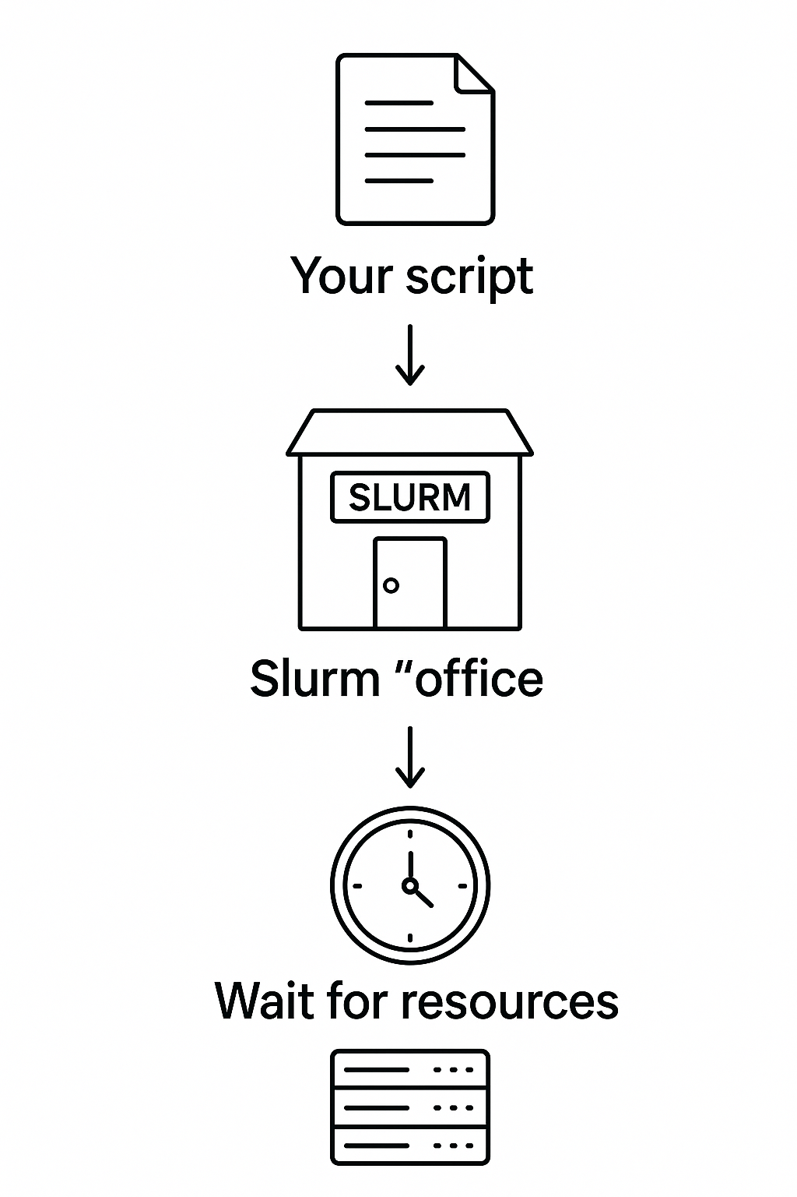
Scripting on the cluster — Slurm: sbatch
What is sbatch?
Command to submit a job script to Slurm; runs in the background on compute nodes.
Delegate the work to de cluster:
Submit once, let the cluster work
Example:
Your script → Slurm "office" → Wait for resources → Cluster runs it

Slide 5

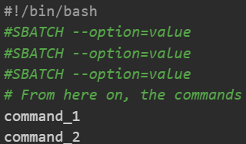
Scripting on the cluster — Slurm: sbatch
Set up a sbatch script file
0) Open a <file-name>.sbatch file
1) Init with shebang

Slide 6
Scripting on the cluster — Slurm: sbatch
Set up a sbatch script file
0) Open a <file-name>.sbatch file
1) Init with shebang
2) Set up slurm directives at the beginning of the script by using “#SBATCH”

Slide 7
Scripting on the cluster — Slurm: sbatch
Set up a sbatch script file
0) Open a <file-name>.sbatch file
1) Init with shebang
2) Set up slurm directives at the beginning of the script by using “#SBATCH”
3) After directives, you can:
Load dependencies with ‘module load’
Set your commands you want to run

Slide 8
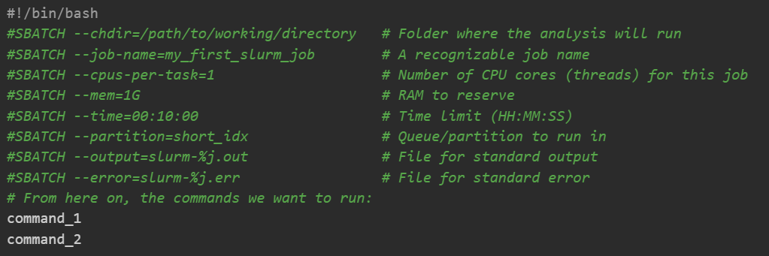
Scripting on the cluster — Slurm: sbatch

Slide 9
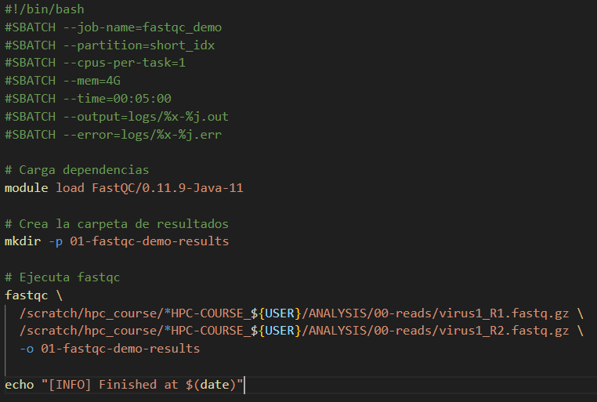

Slide 10
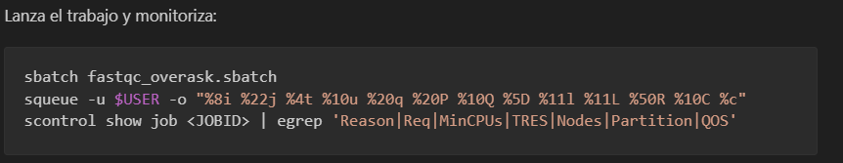
Scripting on the cluster — Slurm: sbatch

Slide 11
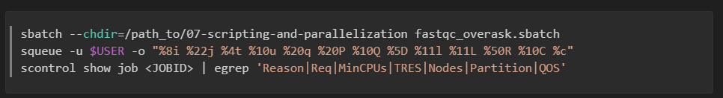
Scripting on the cluster — Slurm: sbatch

Slide 12
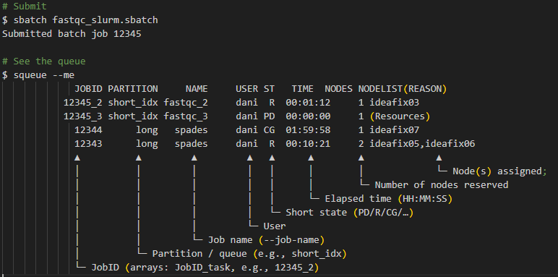
Scripting on the cluster — Slurm: sbatch

Slide 13
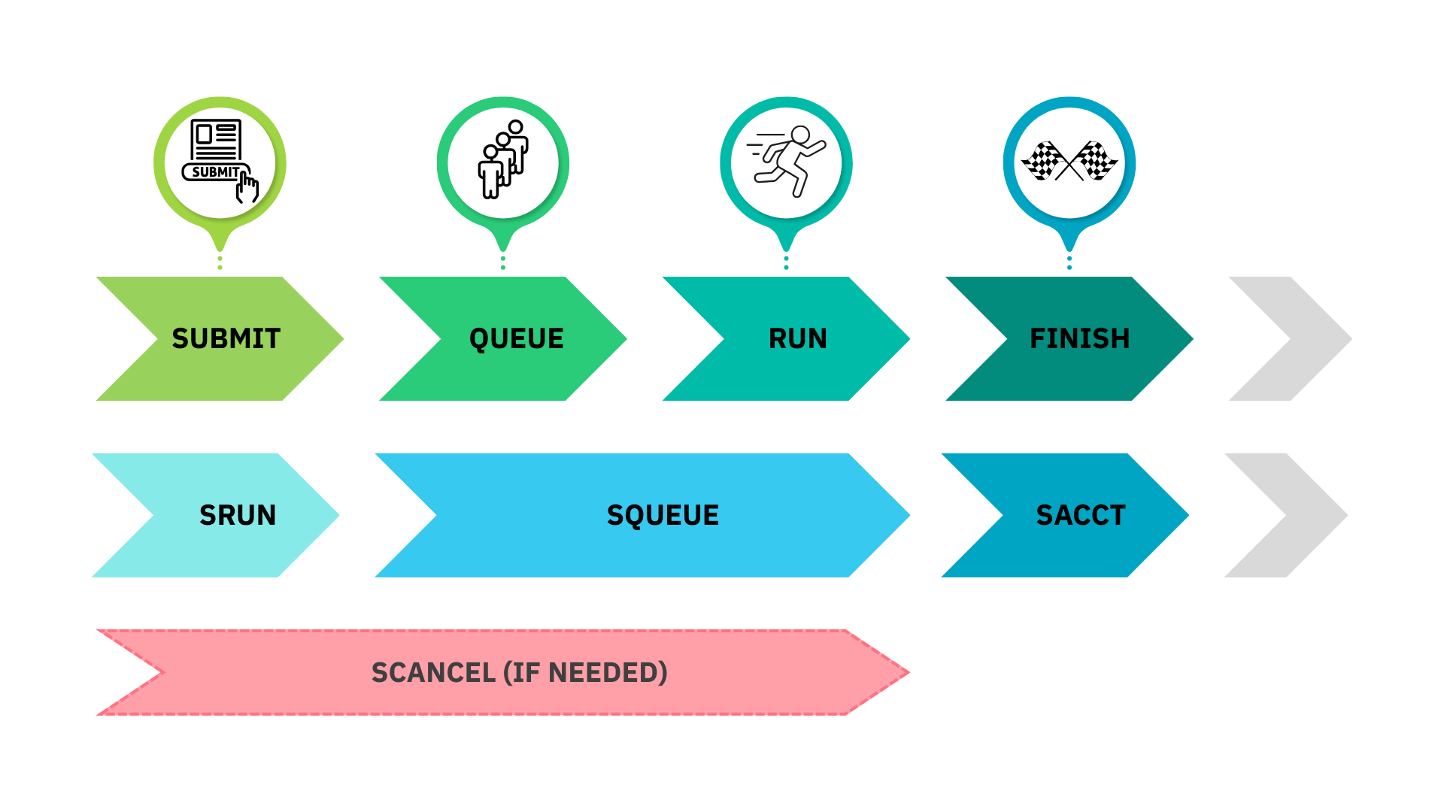
Monitoring and job states
SBATCH

Slide 14
Scripting on the cluster — Slurm: sbatch
Bigger asks = longer wait, not faster.

Slide 15

Scripting on the cluster — Slurm: sbatch
Once the job/s have finished → Output files
Standard output: Standard outputs of your program.
For example, if you used: --output=slurm-%j.out
Standard error: Potential errors you face during execution appear here.
For example, if you used: --error=slurm-%j.err
slurm-12345.out
slurm-12345.err

Slide 16

Scripting on the cluster — Slurm: sbatch
Good Practices:
✅Descriptive --job-name; comment your script.
❌Never run heavy jobs on the login node !!!! Use sbatch/srun.
❌Do not request more resources than need!!!!
✅Test small first, then scale.
✅Version your scripts (Git).

Slide 17
Thank you for your attention
Questions?

Slide 18
JobArrays

Slide 19
Scripting on the cluster — Slurm: job arrays
What are JobArrays and what are they used for?
Sbatch script designed to launch many jobs
Same operation / multiple inputs
Instead of creating 50 scripts for 50 samples, you create one script and tell Slurm to run it N times → In Parallel
If your shell for loop only changes a filename/ID, make it a job array.

Slide 20
Scripting on the cluster — Slurm: job arrays
For Loop
JobArray
Task 1 | fastqc sample1.fastq.gz
Task 1 | fastqc sample1.fastq.gz
1
2
3
4
5
1
2
3
4
5
Task 2 | fastqc sample2.fastq.gz
Task 2 | fastqc sample2.fastq.gz
Task 3 | fastqc sample3.fastq.gz
Task 3 | fastqc sample3.fastq.gz
Task 4 | fastqc sample4.fastq.gz
Task 4 | fastqc sample4.fastq.gz
Task 5 | fastqc sample5.fastq.gz
Time
Time

Slide 21
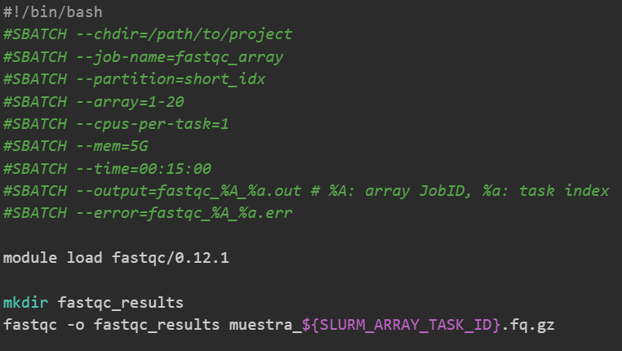
Scripting on the cluster — Slurm: job arrays
Create a JobArray script?
As simple as using the `--array` inside the sbatch script
Plus env variables
https://docs.hpc.shef.ac.uk/en/latest/referenceinfo/scheduler/SLURM/SLURM-environment-variables.html#gsc.tab=0
Notes:
https://docs.hpc.shef.ac.uk/en/latest/referenceinfo/scheduler/SLURM/SLURM-environment-variables.html#gsc.tab=0

Slide 22
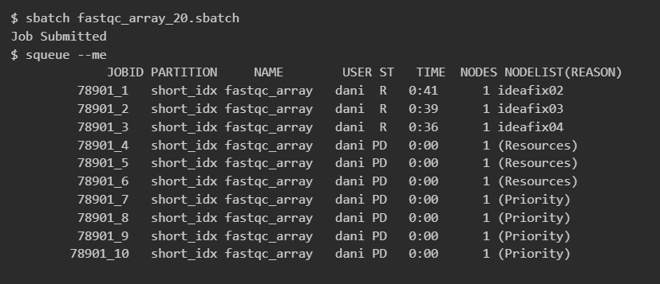
Scripting on the cluster — Slurm: job arrays
Monitoring Arrays

Slide 23
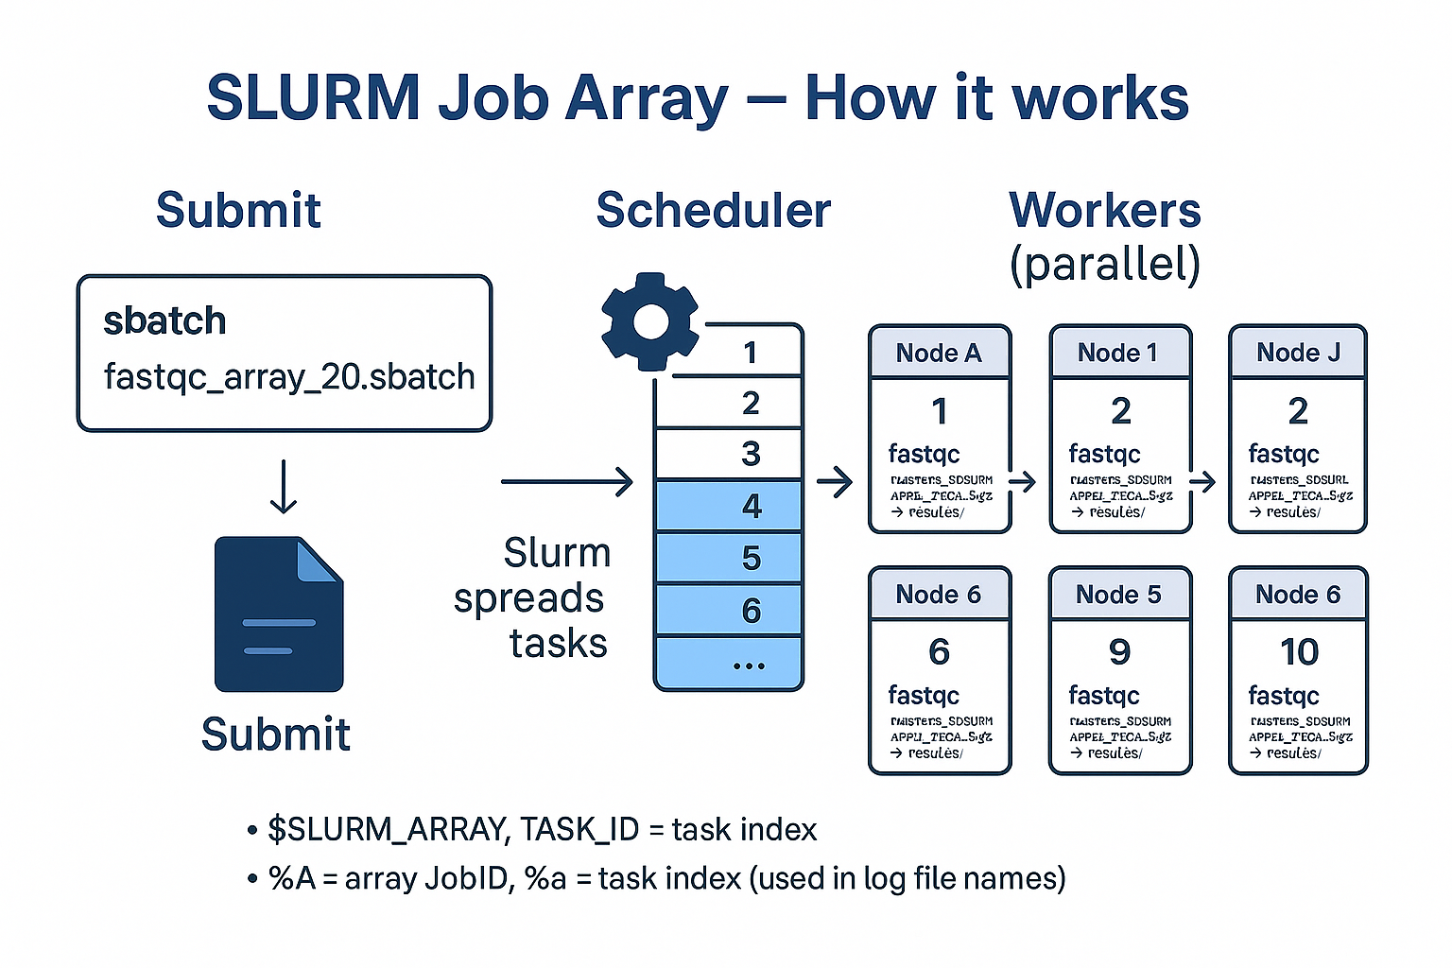
Scripting on the cluster — Slurm: job arrays

Slide 24
Thank you for your attention
Questions?

Slide 25
OpenMP v.s. MPI

Slide 26
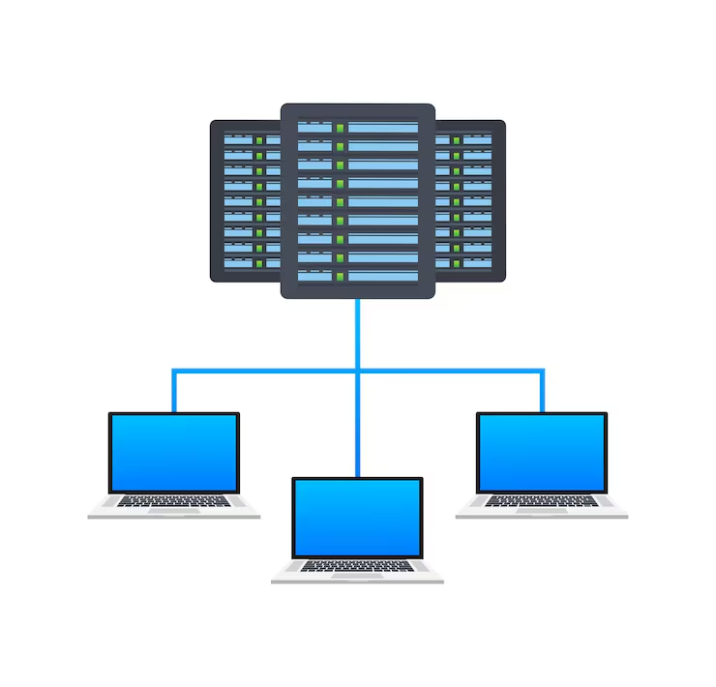
Parallelization on our cluster — OpenMP vs MPI
Parallel programing -- OpenMP and MPI
We use it to finish faster.
It reduces time-to-results, makes better use of cluster resources, and cuts wall-clock time for analyses.
The two most used HPC models are OpenMP and MPI.
They target different scenarios:
OpenMP (shared memory, one node)
vs MPI (distributed memory, many nodes).
Notes:
Parallel programing -- OpenMP and MPI
Parallel programming splits a job into smaller pieces that run at the same time on multiple CPU cores and/or machines.
We use it to finish faster and to handle larger datasets than a single core or single machine can manage.
In HPC, it reduces time-to-results, makes better use of cluster resources, and cuts wall-clock time for analyses.
The two most used HPC models are OpenMP and MPI.
They target different scenarios: OpenMP (shared memory, one node) vs MPI (distributed memory, many nodes).
Parallel programing -- OpenMP and MPI
Parallel programming splits a job into smaller pieces that run at the same time on multiple CPU cores and/or machines.
We use it to finish faster and to handle larger datasets than a single core or single machine can manage.
In HPC, it reduces time-to-results, makes better use of cluster resources, and cuts wall-clock time for analyses.
The two most used HPC models are OpenMP and MPI.
They target different scenarios: OpenMP (shared memory, one node) vs MPI (distributed memory, many nodes).

Slide 27
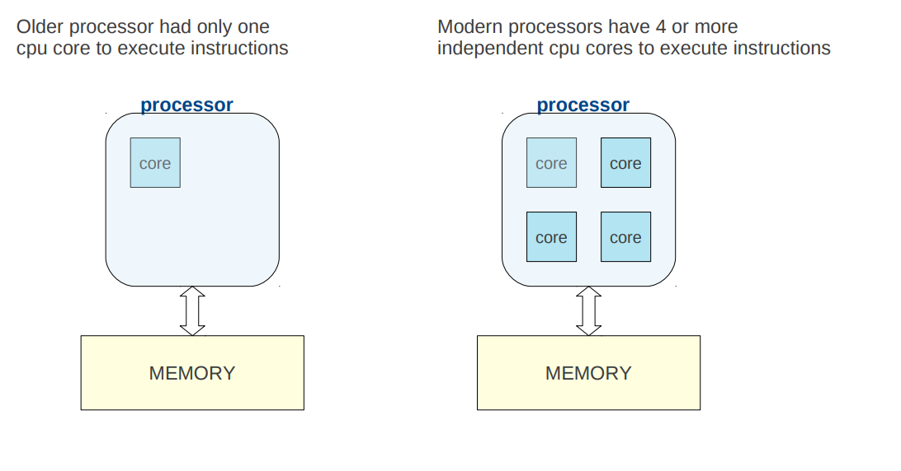
Parallelization on our cluster — OpenMP vs MPI
Parallelization on our cluster — OpenMP
Why parallel computing?
Why parallel computing?

Slide 28
Parallelization on our cluster — OpenMP vs MPI
Parallelization on our cluster — OpenMP
Why parallel computing?
Why parallel computing?

Slide 29
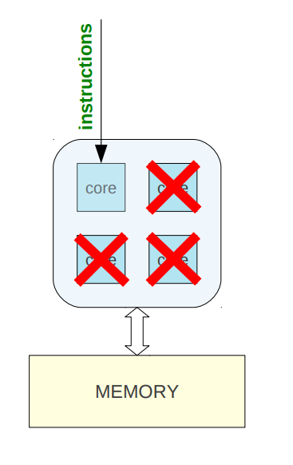
Parallelization on our cluster — OpenMP vs MPI
Why parallel computing?
When you run a sequential program it has an instruction to run a task on 1 core.
Other cores are idle

Slide 30
Parallelization on our cluster — OpenMP vs MPI
Why parallel computing?
When you run a sequential program it has an instruction to run a task on 1 core.
Other cores are idle
Waste of available resources…

Slide 31
Parallelization on our cluster — OpenMP
OpenMP Essentials
Shared-memory parallel model
Lets a program to use multiple threads inside a single process running on a node (usually has >>> CPUs).
That node shares data in a common RAM
Most bioinformatics tools use the OpenMP model
Aligners
Assemblers
Read Processing
Variant Callers
…

Slide 32
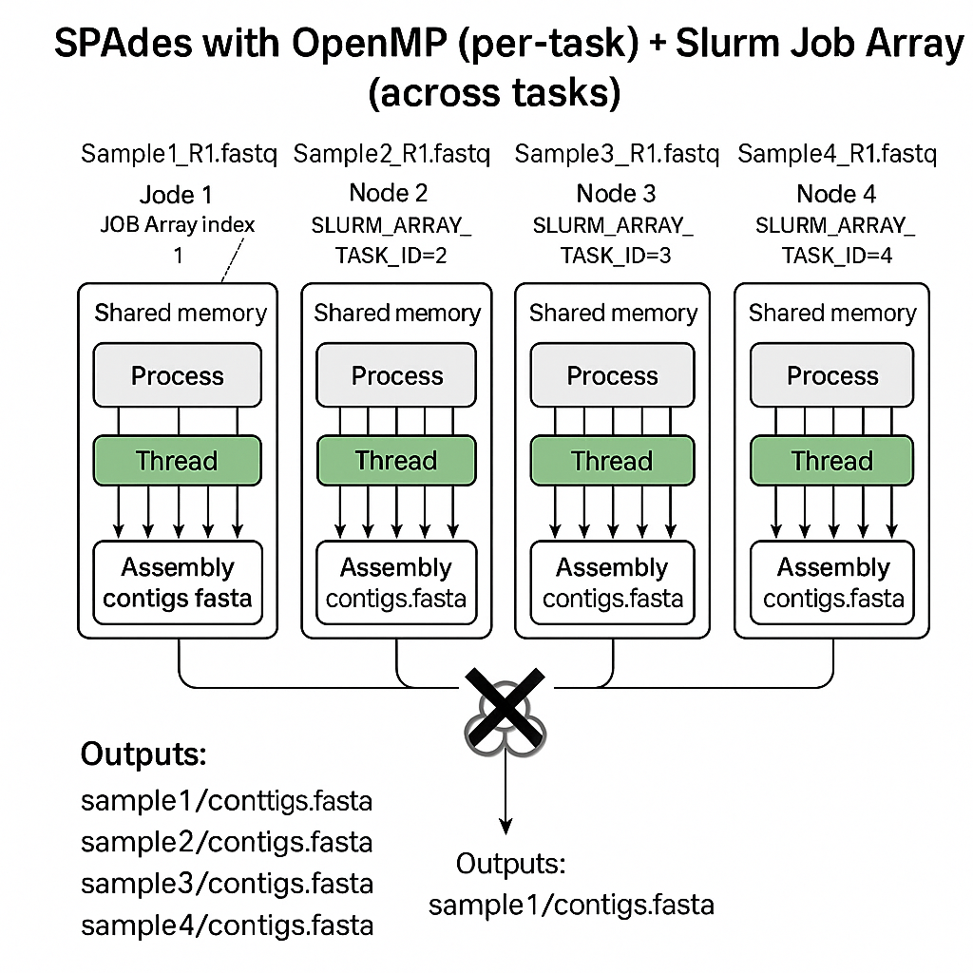
Parallelization on our cluster — OpenMP
Sample 1
Sample 2
Sample 3
Sample 4
OpenMP Essentials
Shared-memory parallel model
Lets a program to use multiple threads inside a single process running on a node (usually has >>> CPUs).
That node shares data in a common RAM
Nodo 1
Nodo 2
Nodo 3
Nodo 1

Slide 33
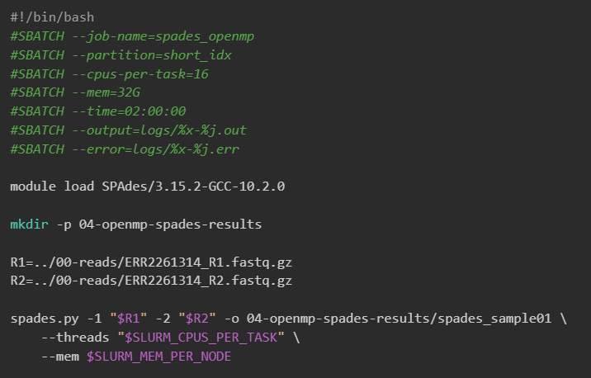
Parallelization on our cluster — OpenMP

Slide 34
Parallelization on our cluster — MPI
MPI Essentials
It is designed to run an application using multiple separate processes, possibly on different nodes of a cluster
When: multinode scaling & very large memory needs.
Shares resources by passing messages over the cluster’s network → network issues can stop the job
Only a few bioinformatics tools use the MPI model
RAxML
IQ-Tree

Slide 35
Parallelization on our cluster — MPI
MPI Essentials
It is designed to run an application using multiple separate processes, possibly on different nodes of a cluster
When: multinode scaling & very large memory needs.
Shares resources by passing messages over the cluster’s network → network issues can stop the job
Otras áreas
Modelos de propagación de enfermedades
Reconstrucción de imágenes 3D
Modelos climáticos y de contaminación
Sincronización de modelos ML (gradient descent trees)

Slide 36
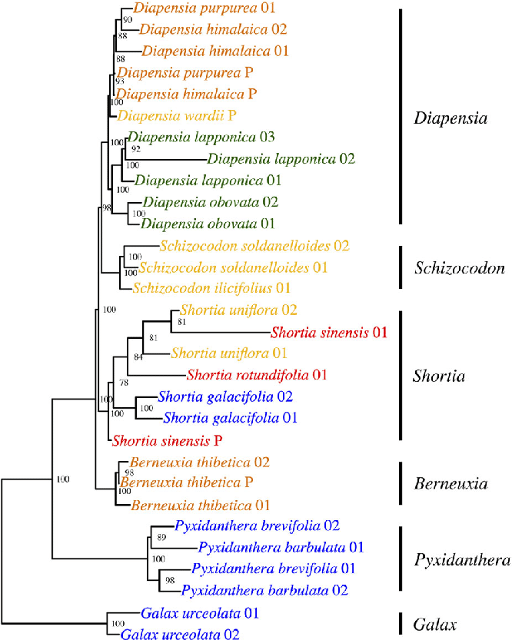
Ejemplo de MPI con herramienta bioinfo RAxML
Imagina un alineamiento de 100.000 secuencias.
No cabe en memoria de un solo nodo.
Necesitas usar varios nodos, cada uno procesa una parte del árbol y comparten información vía mensajes.

Slide 37
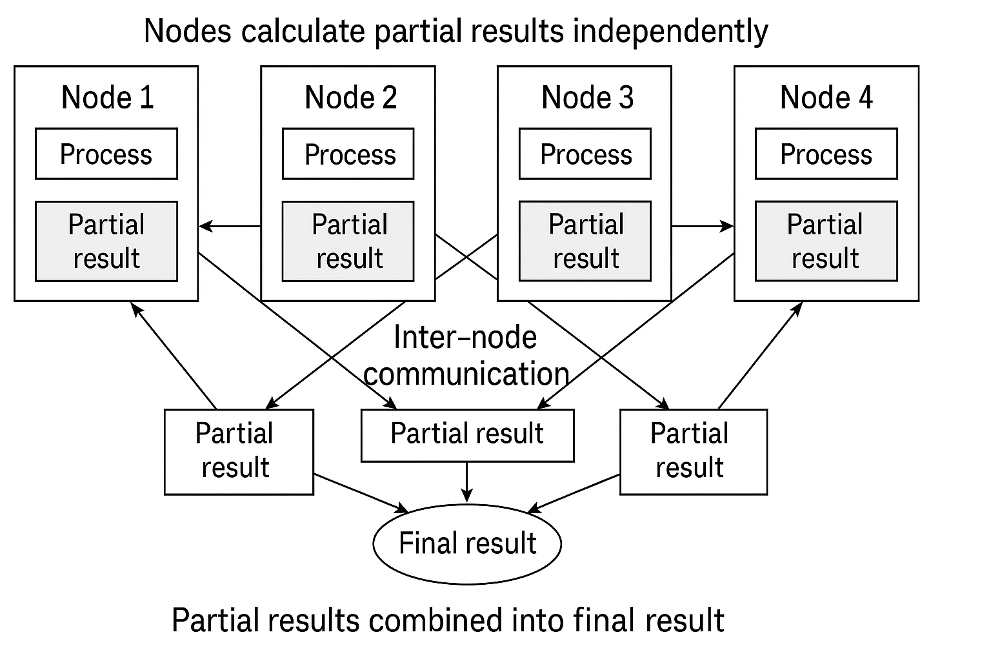
Ejemplo de MPI con herramienta bioinfo RAxML

Slide 38
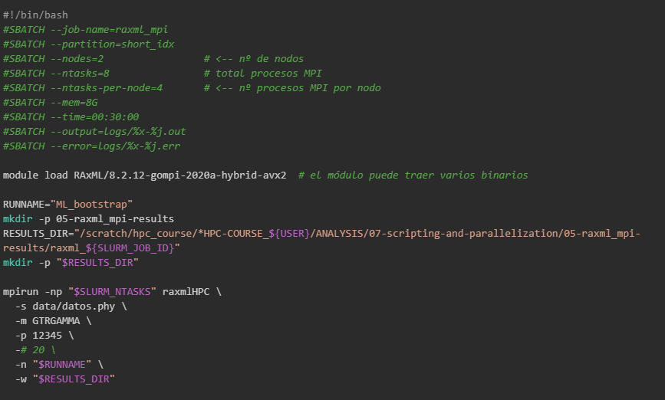
Ejemplo de MPI con herramienta bioinfo RAxML

Slide 39
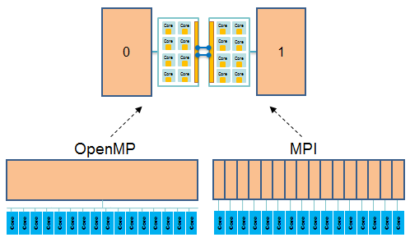
Summary
OpenMP
launch one process per node, just on a single node
share data using shared memory
can't share data with a different process
MPI
launch one process per core, on one node or on many nodes.
pass messages among processes without concern for node location: allows intra and inter node communication.
https://cvw.cac.cornell.edu/hybrid-openmp-mpi/intro/node-views

Slide 40
Parallelization on our cluster — OpenMP vs MPI
KEY DIFFERENCES
Technology | Parallelization level | Communication between processes | Typical use case | Usage (sbatch script)
OpenMP | Within one node | Shared memory: all threads access the same RAM | Align 200 million reads on one node using all its cores | --cpus-per-task (threads) --mem (Ram for the whole process)
MPI | Across multiple nodes | Distributed memory: each node has its own RAM; communication by network | Build a very large phylogenetic tree by splitting the work over 4 nodes | --nodes --ntasks --ntasks-per-node

Slide 41
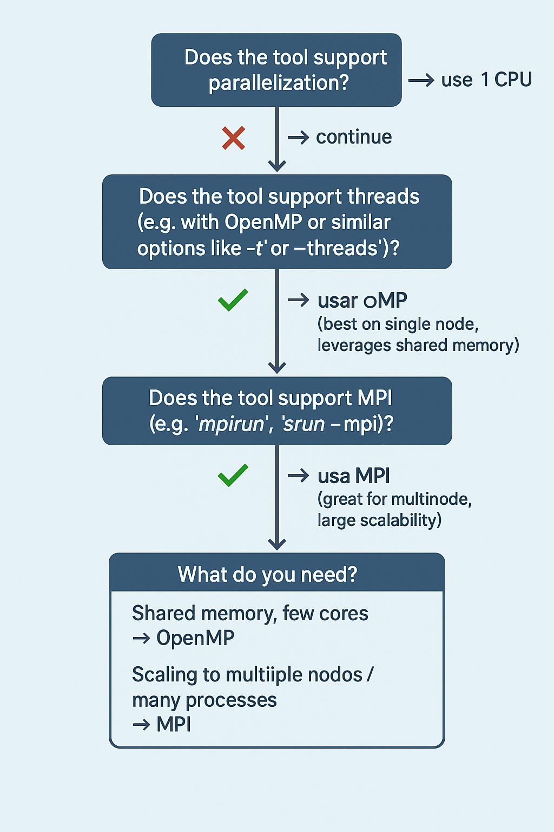
Parallelization on our cluster — OpenMP vs MPI
When to use OpenMP vs MPI?

Slide 42
Thank you for your attention
Questions?

Slide 43
HANDS-ON

